Slide 1
Chronomancer Vertical Slice
Alex Hughes

Slide 2
Game Description
Player is a novice Chronomancer, time wizard
Bad event will unravel the universe
Open market stand to give people “time” from player’s life
Right people show up leads to player saving world

Slide 3
Deployment
Platforms: itch.io, Steam
Made itch.io account

Slide 4
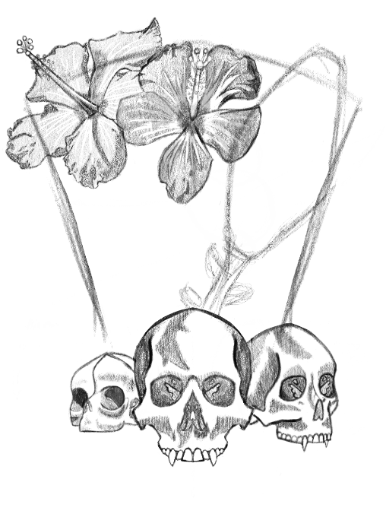
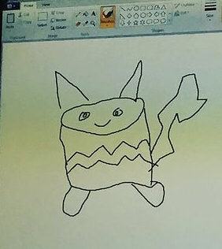
Schedule
I am personally going to murder the inventor of .json files (in minecraft)
60% (art, events available in game)
New artist “hired” recently

Slide 5
Review Feedback
The game window is BIGGER and the background SHOULDN’T BE PINK
Prototype speedrun skips (events repeating for gameplay loop) removed
Json file instead of goofy aaahhhh event setup
(who invented .json I just want to talk)

Slide 6
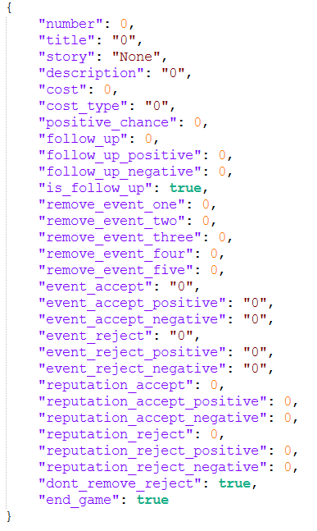
Issues and Observations
-Somehow the only people that had issues with json files only had issues with arrays and I’m the only json user that had issues using a list
-Need to implement threat system for certain events, may be an issue because of the different mechanics of each
-Art takes time (no way)

Slide 7
Planned Tasks for next Iteration
-Add Mafia, Rogue Scientists, Time Anomaly story arcs with threat mechanic in place for each
-Main background
-More characters
-Early cutscene (comic panel like penguin noir)
-remove Nathan Peckham’s work (funy)
-Sound effects exist

Slide 8
Vertical Slice demo
There’s a 50/50 chance I got it working this morning

